Slide 1

Virtual Learning in Rural Districts for English Learners
Rachel Counce

Slide 2
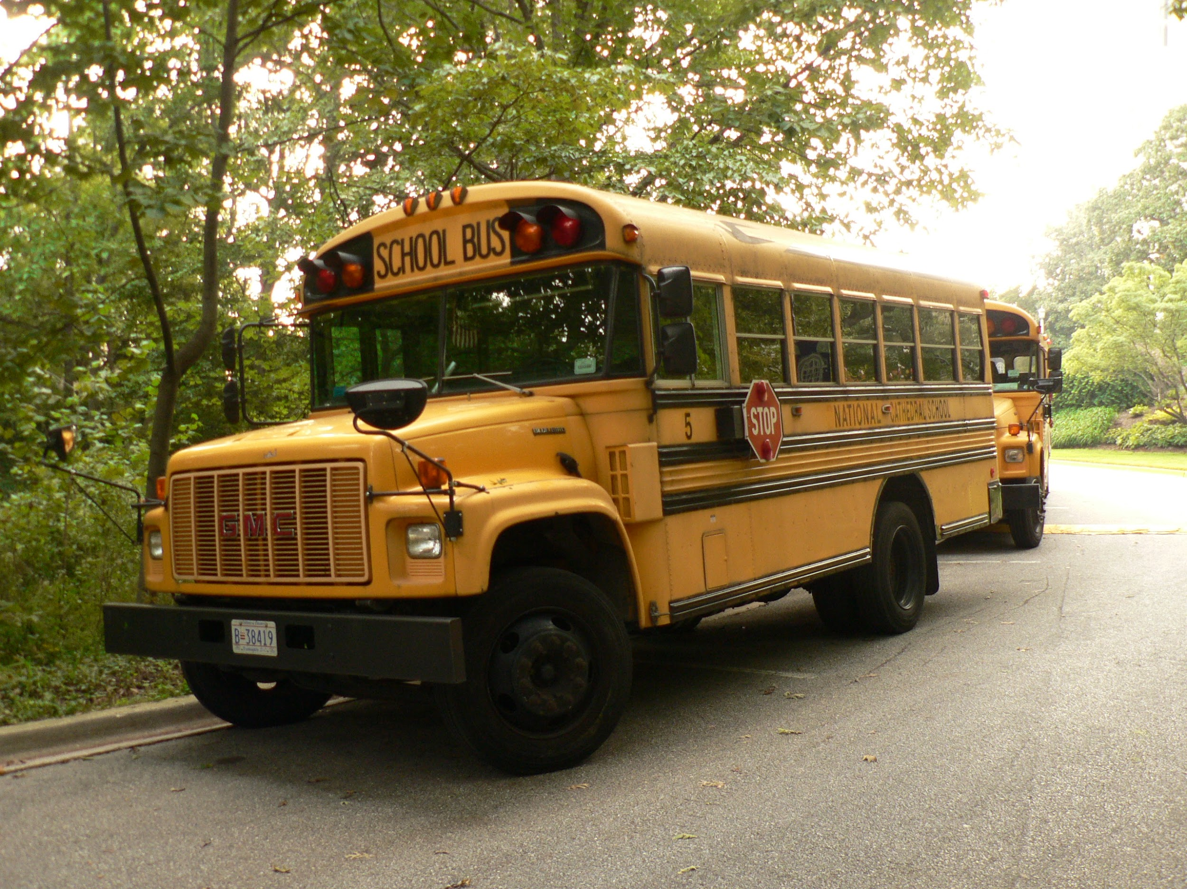
English Learners in Rural Districts
English Learners are the fastest growing subgroup.
Unique challenges: access to internet, remoteness, serving multiple grades, limited resources
These are uncertain times, we don’t know what will happen.
Do what works best for your district.

Slide 3

Rural Districts: Start with Requirements
Districts are legally obligated to communicate with EL families in a language they can understand.
Content teachers must accommodate instruction to make grade-level content accessible to ELs.
All ELs shall have an ILP with a growth trajectory and goals.

Slide 4

Change of Mindset
How do I meet ELL requirements no matter what model my district is using? (on site, blended, virtual)
How can I serve my students most effectively this year?
How do I support content instruction as well as teach English virtually?

Slide 5
Consistency is Key
Great year to increase co-teaching scenarios and support ELs in their grade-level classrooms.
Teach language through content.
Support classroom teachers with scaffolding, graphic organizers, sentence frames, frontloading vocabulary and incorporating language goals.
Align practices with what is being done at the classroom, school, and district level. (Google Classroom in my district)
Look for ESL components or supports your district will be using. (Achieve 3000, Discovery Ed, Ready Math, ELA Curriculum for each grade)

Slide 6
Focus on relationships and a mindset of shared ownership/responsibility. These are our students, not my students, how can we all help English Learners succeed? You cannot do it alone.

Slide 7
Parents/Families
Parents need us now more than ever! We need them too.
Parents need to hear you say that what they are doing is okay.
They do not have to have internet or a computer.
Make sure families have access to resources: food, health, updates.
Communicate regularly.
Encourage students to READ and develop their home language.
Parents can help with routines and expectations for virtual/home learning.

Slide 8

School Personnel
Content/Grade level Teachers need help.
El Maestro
Scaffolding content digitally- (visuals, sentence frames, graphic organizers).
Home language support for content areas
Communicating with EL families
Use the ILP as a collaboration tool to share each student’s portrait, background information, proficiency levels.

Slide 9

Administrators
Help with scheduling
Provide shared planning for EL and content teachers or other ways to collaborate.
Advocate for students and resources
Be proactive, let Admin know what you need to make virtual learning more successful. You won’t know if you don’t ask.

Slide 10


Para Professionals/Volunteers
Roles may change this year.
They call to see what I need. You are not alone. Allow others to help you.
Translate
Parent outreach
Newcomer Support
Paper packets
Cleaning
Shared responsibilities of the school

Slide 11

Reach beyond your rural district
Surrounding/similar districts
Facebook- Advocating for ELLs, WIDA Educator Exchange, Leading ELLs, ESL teacher K-12.
Twitter- Katie Toppel, @Toppel_ELD, Emily Francis, @emilyfranESL, Tan K Huynh @TanKHuynh, Valentina Gonzalez, @ValentinaESL
Youtube-Miss Dorito #BELIEVE_Cafe
Podcast- Boosting ELL Achievement
Distance Learning for ELLs on Colorin Colorado

Slide 12

Our English Learners
Let them know you care.
Stay connected
Acknowledge that they may be struggling with adult responsibilities.
Be concise, engaging, and reasonable in what you expect from students.
Don’t let your frustration show.

Slide 13

Remember….
Stay calm
Be compassionate
Flexible
Creative
Start with Requirements
Be consistent
Work together
Be Kind

Slide 14

Conclusion…
We know this year will look different no matter what model is used.
We are experts at differentiating and making content accessible.
Do what is best for your kids and your district.

Slide 15

Thank you for what you do for ELs Everyday! Questions???

